Slide 1
Q & A

Slide 2
Ansible Demo 3
Ansible Demo 1: Interact with OpenStack API and provisioned two VMs on MRC
Ansible Demo 2: Configure the VMs and deploy a WordPress stack with Docker Compose
Ansible Demo 3: Combine the Demo 1 and Demo 2
Combined the host_vars and roles together
Removed some optional roles (openstack-images and openstack-volume-snapshot)
Append the playbook file for demo 2 to the playbook file for demo 1
Modified the inventory file

Slide 3
Ansible Demo 3 - Playbook

Slide 4
Ansible Demo 3 - Inventory
# Inventory file: hosts
[COMP90024]
[COMP90024:vars]
ansible_python_interpreter=/usr/bin/python3
ansible_user=ubuntu
ansible_ssh_private_key_file=<my private key file>
ansible_ssh_common_args='-o StrictHostKeyChecking=no'
ansible-playbook -u ubuntu --key-file <private key> …
How to build your inventory

Slide 5

Ansible Quiz
Retrieve facts about the instance created
Create an instance and retrieve facts about that instance
Use in-memory inventory to interact with a newly created instance (see demo 3)
Attach existing volume(s) to an existing instance
Create a new volume
Attach the new volume to an existing instance
Hint:
Go to the Ansible Documentation and search docs for “os volume”
Find relevant Ansible module -> os_server_volume

Slide 6
Ansible Quiz
Add / remove existing Security Group to existing instance
Create a new Security Group
Add Security Group Rules
Attach the Security Group to an existing instance
Hint: os_server
Remember to include the existing security groups while adding / removing security groups

Slide 7

Question 1
I am trying to set up a CouchDB cluster, and in order to do that I'd have to modify my security group setting to open up the ports that CouchDB nodes need to use for communication. … I don't really feel like using a nested loop, … Just wondering if there is any other way of doing this?
Server A: open 5984, 5986, 4369, 9100 – 9200 to Server B and Server C
Server B: open 5984, 5986, 4369, 9100 – 9200 to Server A and Server C
Server C: open 5984, 5986, 4369, 9100 – 9200 to Server A and Server B
Problem: remote_ip_prefix only takes a single CIDR notation.
Solution? A nested loop with “with_nested”? Try and tell me if it works ;p
Solution! Use the security group as the source of the remote in a security rule.

Slide 8
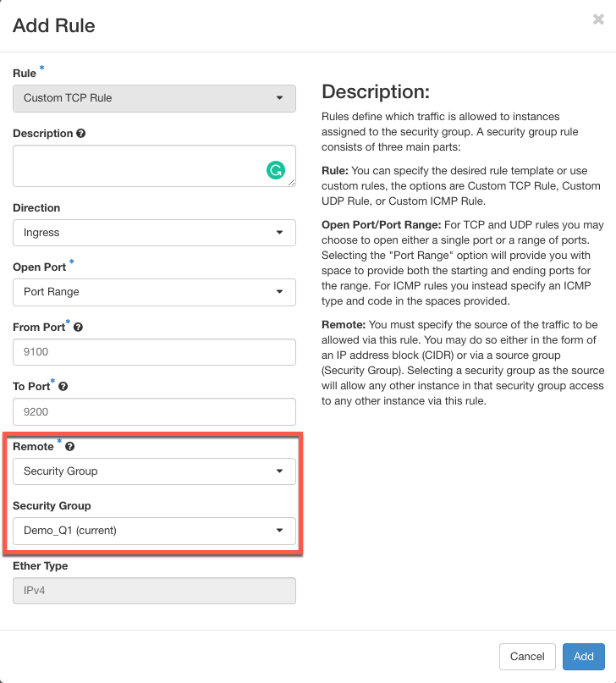


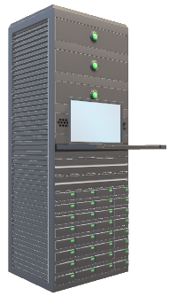
Question 1
Demo_Q1
9100 - 9200
9100 - 9200
9100 - 9200

Slide 9
Question 2
Q: Random errors, even when run simple “hello world” playbook or the playbooks used in demo.
A: Check Ansible version and make sure the latest Ansible has been installed.
ansible --version

Slide 10
Question 3
Q: Cannot SSH to the server just created on NeCTAR / MRC
A: The servers are not ready. Use wait_for module to wait until the servers are ready.

Slide 11
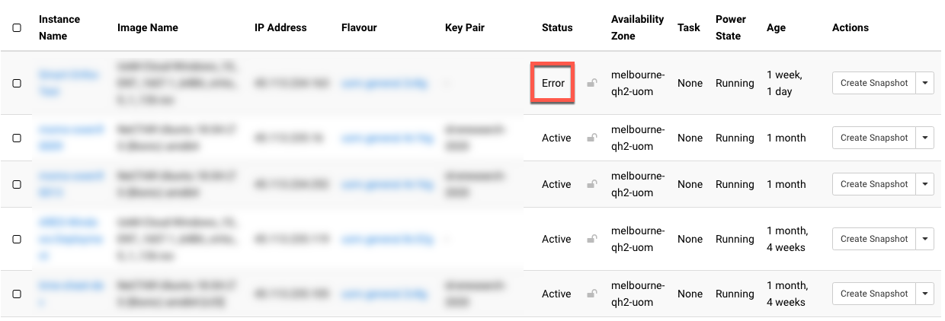

Question 4
Q: I created an instance on MRC and the status showing “Error”
A: Welcome to the FREE cloud. It happens, try to delete the instance if you can. Otherwise Submit a Ticket and the MRC staff will help you out.

Slide 12
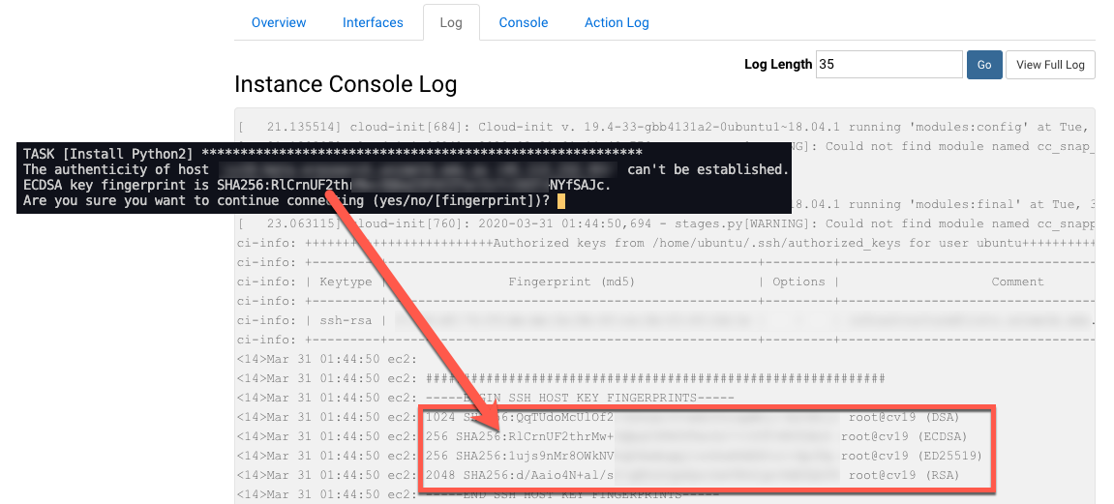
Question 5
Q: How to check the host key fingerprint?

Slide 13
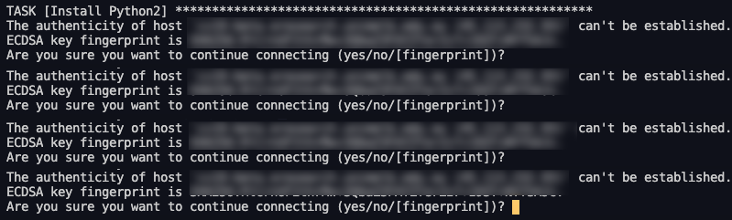
Question 6
Q: Ansible keeps prompting host key confirmation, sometimes type “yes” only works for the first host.

Slide 14
Question 6
A: SSH with “-o StrictHostKeyChecking=no” option
[COMP90024]
[COMP90024:vars]
ansible_python_interpreter=/usr/bin/python3
ansible_user=ubuntu
ansible_ssh_private_key_file=<some private key>
ansible_ssh_common_args='-o StrictHostKeyChecking=no'

Slide 15
Question 7
Q: How to safely store the Ansible variables for credentials in a Git repo?
A: Don’t push it or use Ansible Vault.
To encrypt a file: ansible-vault encrypt file.yaml
To decrypt a file: ansible-vault decrypt file.yaml
To view an encrypted file: ansible-vault view file.yaml
To run an encrypted playbook file:
ansible-playbook --vault-id @prompt file.yaml

Slide 16
Question 8
Q: How to create an instance with a specific network provider (e.g. qh2-uom-internal)?
A: Use “network” in “os_server”

Slide 17

Question 9
Q: What can we do if we want multiple instances to access data stored in a volume? Can we do this by Ansible?
A: Yes and No.
Yes: OpenStack supports multi-attach since Cinder version 3.50.
No: NeCTAR / MRC does not support multi-attach

Slide 18
Question 10
Q: How to use Ansible to add the proxy?
A: reboot
blockinfile

